Slide 1
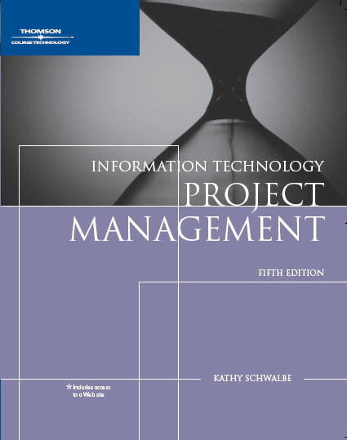
Chapter 5: Project Scope Management
Information Technology Project Management

Slide 2
Learning Objectives
Understand the elements that make good project scope management important
Explain the scope planning process and describe the contents of a scope management plan
Describe the process for developing a project scope statement using the project charter and preliminary scope statement
Discuss the scope definition process and work involved in constructing a work breakdown structure using the analogy, top-down, bottom-up, and mind-mapping approaches

Slide 3
Learning Objectives (continued)
Explain the importance of scope verification and how it relates to scope definition and control
Understand the importance of scope control and approaches for preventing scope-related problems on information technology projects
Describe how software can assist in project scope management

Slide 4
What is Project Scope Management?
Scope refers to all the work involved in creating the products of the project and the processes used to create them
A deliverable is a product produced as part of a project, such as hardware or software, planning documents, or meeting minutes
Project scope management includes the processes involved in defining and controlling what is or is not included in a project

Slide 5
Project Scope Management Processes
Scope planning: deciding how the scope will be defined, verified, and controlled
Scope definition: reviewing the project charter and preliminary scope statement and adding more information as requirements are developed and change requests are approved
Creating the WBS: subdividing the major project deliverables into smaller, more manageable components
Scope verification: formalizing acceptance of the project scope
Scope control: controlling changes to project scope

Slide 6
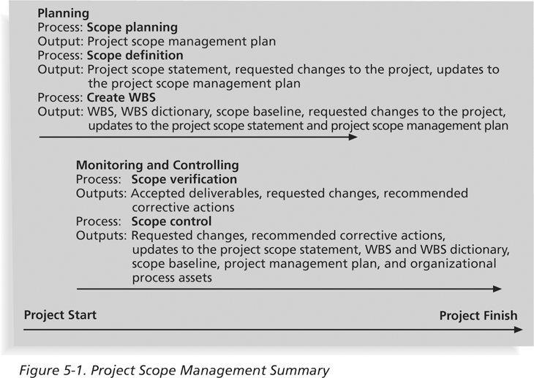
Figure 5-1: Project Scope Management Summary

Slide 7
Scope Planning and the Scope Management Plan
The scope management plan is a document that includes descriptions of how the team will prepare the project scope statement, create the WBS, verify completion of the project deliverables, and control requests for changes to the project scope
Key inputs include the project charter, preliminary scope statement, and project management plan

Slide 8
What Went Right?
Many financial service companies use customer relationship management (CRM) systems to improve their understanding of and responsiveness to customers
A senior management team at the Canadian money management company Dynamic Mutual Funds (DMF) launched an enterprise-wide, national program to build and manage its customer relationships
They needed a faster and more organized, highly participative approach, so they proposed a new seven-step concept called project scope design
DMF won an eCustomer World Golden Award for world-class innovation

Slide 9
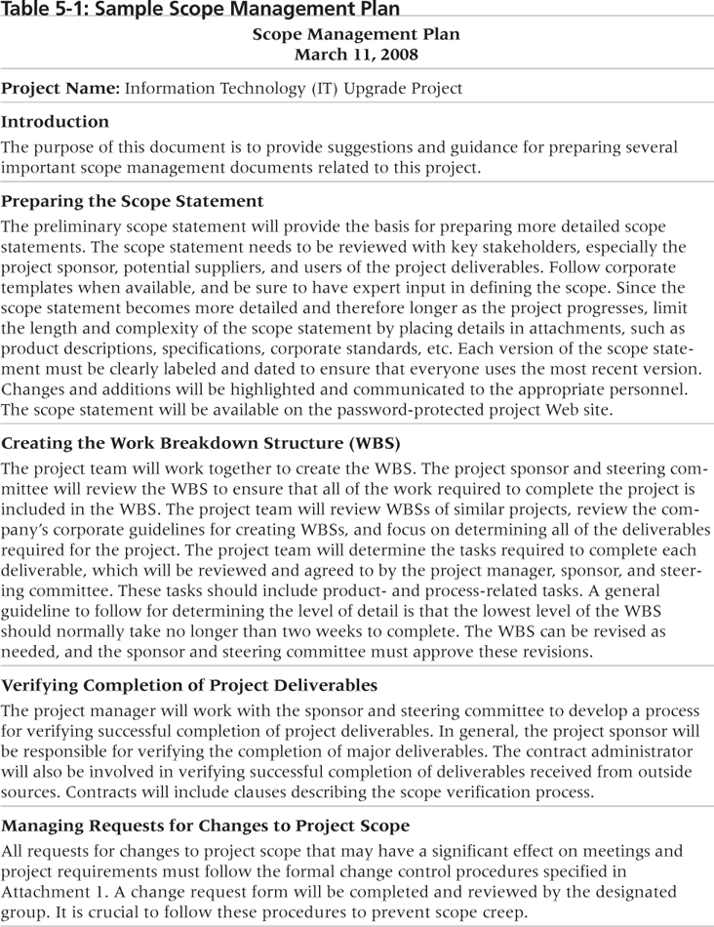
Table 5-1: Sample Scope Management Plan

Slide 10
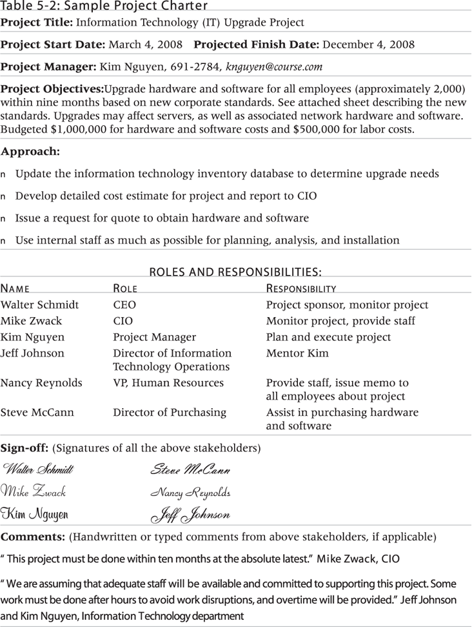
Table 5-2: Sample Project Charter

Slide 11
Scope Definition and the Project Scope Statement
The preliminary scope statement, project charter, organizational process assets, and approved change requests provide a basis for creating the project scope statement
As time progresses, the scope of a project should become more clear and specific

Slide 12
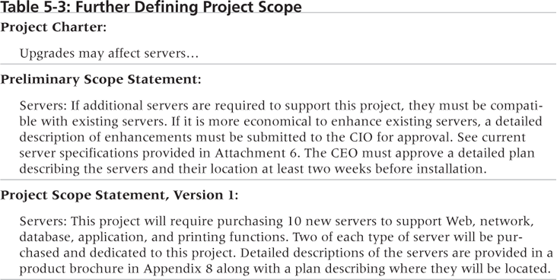
Table 5-3: Further Defining Project Scope

Slide 13
Media Snapshot
Many people enjoy watching television shows like Changing Rooms or Trading Spaces, where participants have two days and $1,000 to update a room in their neighbor’s house. Since the time and cost are set, it’s the scope that has the most flexibility. Designers on these shows often have to change initial scope goals due to budget or time constraints.
Although most homeowners are very happy with work done on the show, some are obviously disappointed. Unlike most projects where the project team works closely with the customer, homeowners have little say in what gets done and cannot inspect the work along the way… What happens when the homeowners don’t like the work that’s been done? The FAQ section of tlc.com says, “Everyone on our show is told upfront that there’s a chance they won’t like the final design of the room. Each applicant signs a release acknowledging that the show is not responsible for redecorating a room that isn’t to the owner’s taste.”
Too bad you can’t get sponsors for most projects to sign a similar release form. It would make project scope management much easier!

Slide 14
Creating the Work Breakdown Structure (WBS)
A WBS is a deliverable-oriented grouping of the work involved in a project that defines the total scope of the project
WBS is a foundation document that provides the basis for planning and managing project schedules, costs, resources, and changes
Decomposition is subdividing project deliverables into smaller pieces
A work package is a task at the lowest level of the WBS

Slide 15
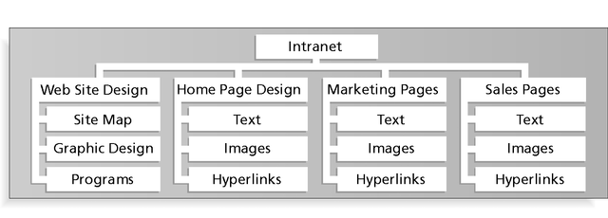
Figure 5-2: Sample Intranet WBS Organized by Product

Slide 16
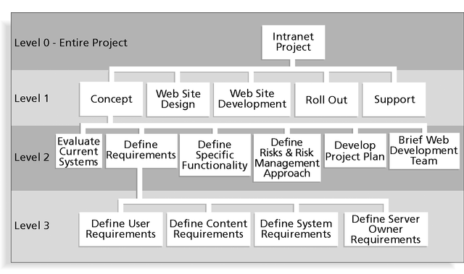
Figure 5-3: Sample Intranet WBS Organized by Phase

Slide 17
Table 5-4: Intranet WBS in Tabular Form
1.0 Concept
1.1 Evaluate current systems
1.2 Define Requirements
1.2.1 Define user requirements
1.2.2 Define content requirements
1.2.3 Define system requirements
1.2.4 Define server owner requirements
1.3 Define specific functionality
1.4 Define risks and risk management approach
1.5 Develop project plan
1.6 Brief Web development team
2.0 Web Site Design
3.0 Web Site Development
4.0 Roll Out
5.0 Support

Slide 18
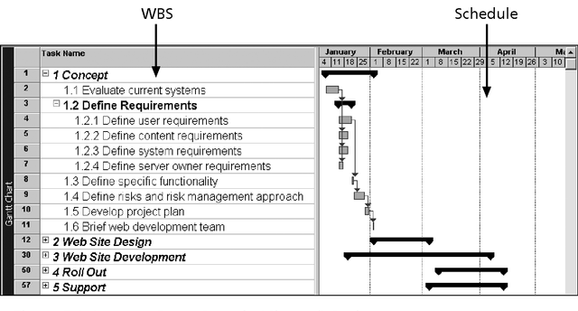
Figure 5-4: Intranet WBS and Gantt Chart in Microsoft Project

Slide 19
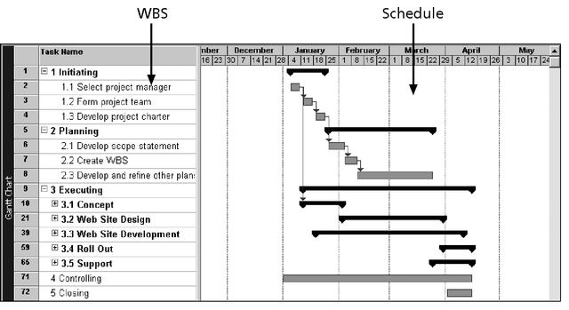
Figure 5-5: Intranet Gantt Chart Organized by Project Management Process Groups

Slide 20
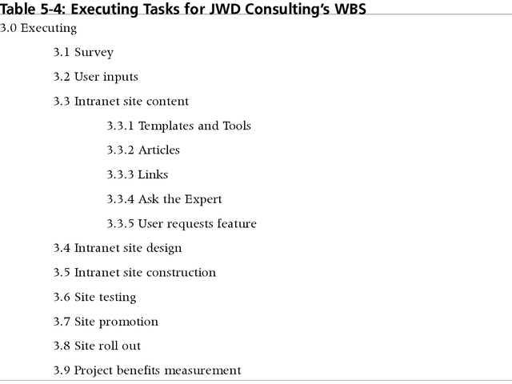
Table 5-5: Executing Tasks for JWD Consulting’s WBS

Slide 21
Approaches to Developing WBSs
Using guidelines: some organizations, like the DOD, provide guidelines for preparing WBSs
The analogy approach: review WBSs of similar projects and tailor to your project
The top-down approach: start with the largest items of the project and break them down
The bottom-up approach: start with the specific tasks and roll them up
Mind-mapping approach: mind mapping is a technique that uses branches radiating out from a core idea to structure thoughts and ideas

Slide 22
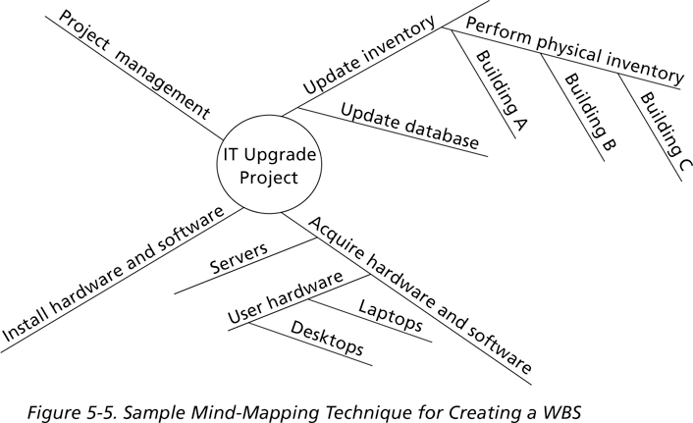
Figure 5-6: Sample Mind-Mapping Approach for Creating a WBS

Slide 23
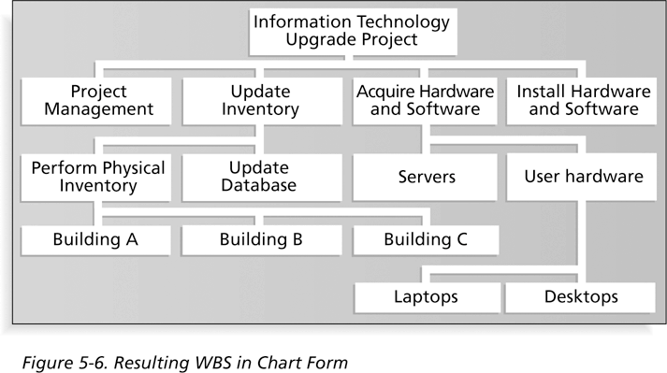
Figure 5-7: Resulting WBS in Chart Form

Slide 24
The WBS Dictionary and Scope Baseline
Many WBS tasks are vague and must be explained more so people know what to do and can estimate how long it will take and what it will cost to do the work
A WBS dictionary is a document that describes detailed information about each WBS item
The approved project scope statement and its WBS and WBS dictionary form the scope baseline, which is used to measure performance in meeting project scope goals

Slide 25
Advice for Creating a WBS and WBS Dictionary*
A unit of work should appear at only one place in the WBS
The work content of a WBS item is the sum of the WBS items below it
A WBS item is the responsibility of only one individual, even though many people may be working on it
The WBS must be consistent with the way in which work is actually going to be performed; it should serve the project team first, and other purposes only if practical
*Cleland, David I. Project Management: Strategic Design and Implementation, 1994

Slide 26
Advice for Creating a WBS and WBS Dictionary (continued)*
Project team members should be involved in developing the WBS to ensure consistency and buy-in
Each WBS item must be documented in a WBS dictionary to ensure accurate understanding of the scope of work included and not included in that item
The WBS must be a flexible tool to accommodate inevitable changes while properly maintaining control of the work content in the project according to the scope statement
*Cleland, David I. Project Management: Strategic Design and Implementation, 1994

Slide 27
What Went Wrong?
A project scope that is too broad and grandiose can cause severe problems
Scope creep and an overemphasis on technology for technology’s sake resulted in the bankruptcy of a large pharmaceutical firm, Texas-based FoxMeyer Drug
In 2001, McDonald’s fast-food chain initiated a project to create an intranet that would connect its headquarters with all of its restaurants to provide detailed operational information in real time; after spending $170 million on consultants and initial implementation planning, McDonald’s realized that the project was too much to handle and terminated it

Slide 28
Scope Verification
It is very difficult to create a good scope statement and WBS for a project
It is even more difficult to verify project scope and minimize scope changes
Scope verification involves formal acceptance of the completed project scope by the stakeholders
Acceptance is often achieved by a customer inspection and then sign-off on key deliverables

Slide 29
Scope Control
Scope control involves controlling changes to the project scope
Goals of scope control are to:
Influence the factors that cause scope changes
Assure changes are processed according to procedures developed as part of integrated change control
Manage changes when they occur
Variance is the difference between planned and actual performance

Slide 30
Best Practices for Avoiding Scope Problems
1. Keep the scope realistic: Don’t make projects so large that they can’t be completed; break large projects down into a series of smaller ones
2. Involve users in project scope management: Assign key users to the project team and give them ownership of requirements definition and scope verification
3. Use off-the-shelf hardware and software whenever possible: Many IT people enjoy using the latest and greatest technology, but business needs, not technology trends, must take priority
4. Follow good project management processes: As described in this chapter and others, there are well-defined processes for managing project scope and others aspects of projects

Slide 31
Suggestions for Improving User Input
Develop a good project selection process and insist that sponsors are from the user organization
Have users on the project team in important roles
Have regular meetings with defined agendas, and have users sign off on key deliverables presented at meetings
Deliver something to users and sponsors on a regular basis
Don’t promise to deliver when you know you can’t
Co-locate users with developers

Slide 32
Suggestions for Reducing Incomplete and Changing Requirements
Develop and follow a requirements management process
Use techniques such as prototyping, use case modeling, and JAD to get more user involvement
Put requirements in writing and keep them current
Create a requirements management database for documenting and controlling requirements

Slide 33
Suggestions for Reducing Incomplete and Changing Requirements (continued)
Provide adequate testing and conduct testing throughout the project life cycle
Review changes from a systems perspective
Emphasize completion dates to help focus on what’s most important
Allocate resources specifically for handling change requests/enhancements like NWA did with ResNet

Slide 34
Using Software to Assist in Project Scope Management
Word-processing software helps create several scope-related documents
Spreadsheets help to perform financial calculations and weighed scoring models, and develop charts and graphs
Communication software like e-mail and the Web help clarify and communicate scope information
Project management software helps in creating a WBS, the basis for tasks on a Gantt chart
Specialized software is available to assist in project scope management

Slide 35
Chapter Summary
Project scope management includes the processes required to ensure that the project addresses all the work required, and only the work required, to complete the project successfully
Main processes include:
Scope planning
Scope definition
Creating the WBS
Scope verification
Scope control

